Slide 1
19 – Representing and mining text
Dave Eargle – CU Boulder

Slide 2
Why text is important
Think of an industry. What are some text-based data sources that might hold useful mine-able data?
Example industries:
Medical
Customer service
Social media
Online sales
What are some interesting internet-related text sources?
“web pages, Twitter feeds, email, Facebook status updates, product descriptions, Reddit comments, blog postings”
How do you think search engines work?

Slide 3
Why text is difficult
Why do you think text is difficult to use for predictive analytics? Think, for example, of a reddit post.
“unstructured” (if you ask a computer)
By comparison a “csv” is extremely structured
order of words sometimes matters
dirty – bad grammar, spacing, abbreviation, punctuation, synonyms, homographs, meaning changes across domains
context matters
Example movie review: “The first part of this movie is far better than the second. The acting is poor and it gets out-of-control by the end, with the violence overdone and an incredible ending, but it’s still fun to watch.”

Slide 4
Representation
document = one piece of text, the unit of analysis
could be as long as a book, or as short as a sentence… still called a “document”
Documents have tokens or terms. For now, consider each “word” to be a separate token
Collection of documents is called a corpus
Think: Given this, how can we turn a set of documents into feature-vector form?
There’s more than one right answer

Slide 5
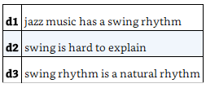
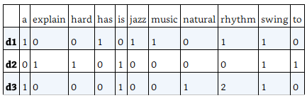
One approach: Bag of words and Term Frequency
Bag of words:
most basic approach, each word is a binary token (feature)
1 if the token is present in the document, 0 otherwise
1
How to convert to feature-vector form?

Slide 6
One approach: Bag of words and Term Frequency
Bag of words with Term Frequency
again, one token for each word
but the value is a count instead of binary – it is a count of the number of times the word appears in the document

Slide 7
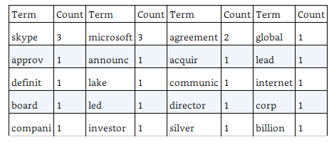
Preparing text data
Microsoft Corp and Skype Global today announced that they have entered into a definitive agreement under which Microsoft will acquire SKYPE, the leading Internet communications company, for $8.5 billion in cash from the investor group led by Silver Lake. The agreement has been approved by the boards of directors of both Microsoft and Skype.
What if the document also contained the word “announcing”?
normalize case
stem the words (remove the suffixes)
remove stopwords
remove numbers
could also normalize the counts by dividing by total number of words in the document
Do we care about “stopwords” like “in”, “from”?

Slide 8
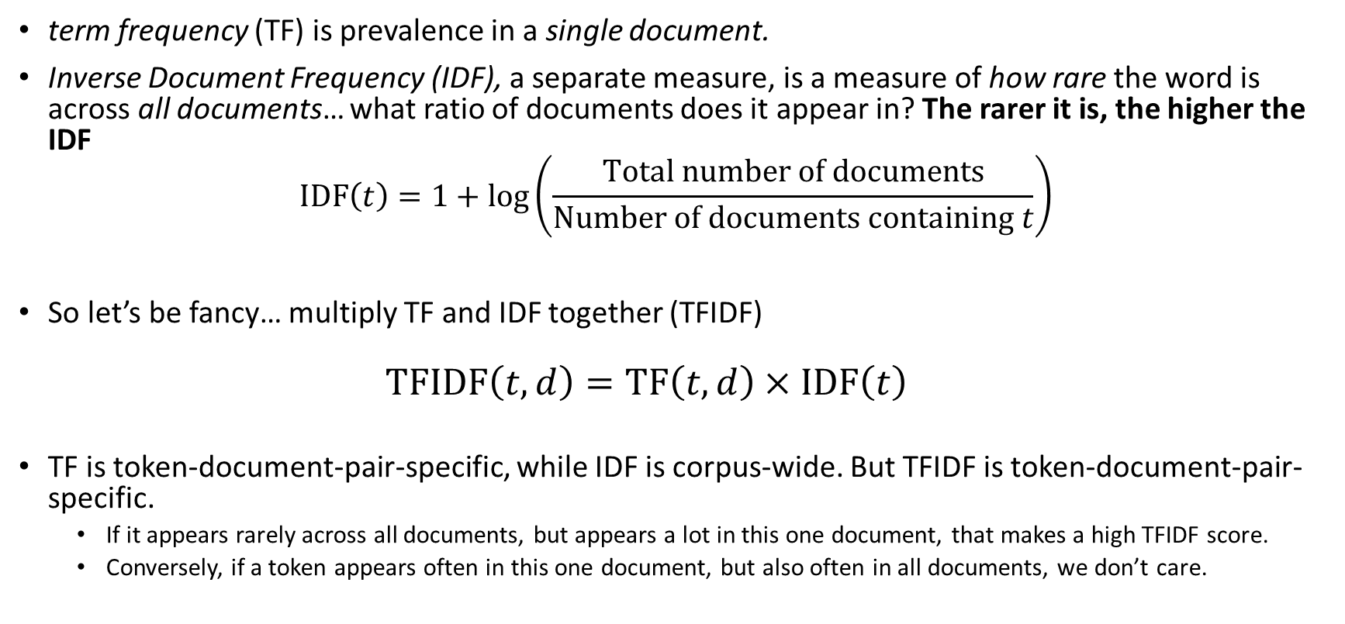
Measuring sparseness: Inverse Document Frequency
term frequency (TF) is prevalence in a single document.
Inverse Document Frequency (IDF), a separate measure, is a measure of how rare the word is across all documents… what ratio of documents does it appear in? The rarer it is, the higher the IDF
$$\text{IDF}\left(t\right)=1+\log\left(\frac{\text{Total} \text{number} \text{of} \text{documents}}{\text{Number} \text{of} \text{documents} \text{containing} t}\right)$$
So let’s be fancy… multiply TF and IDF together (TFIDF)
$$\text{TFIDF}\left(t,d\right)=\text{TF}\left(t,d\right)×\text{IDF}\left(t\right)$$
TF is token-document-pair-specific, while IDF is corpus-wide. But TFIDF is token-document-pair-specific.
If it appears rarely across all documents, but appears a lot in this one document, that makes a high TFIDF score.
Conversely, if a token appears often in this one document, but also often in all documents, we don’t care.

Slide 9
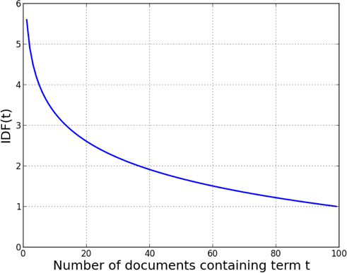
IDF (not TF-IDF) of a term t within a corpus of 100 documents.

Slide 10
Now you have a feature-vector representation!!!
Each document is a feature vector (one row per document). Each feature is a token. The value for each document-token pair can be binary, TF, TF normalized, TFIDF, whatever
So what might you do with your feature-vector representation?
Let’s be a search engine

Slide 11
Example: Jazz Musicians
16 prominent jazz musicians and excerpts of their biographies from Wikipedia

Slide 12
Sample biographies of jazz musicians
Charlie Parker Charles “Charlie” Parker, Jr., was an American jazz saxophonist and composer. Miles Davis once said, “You can tell the history of jazz in four words: Louis Armstrong. Charlie Parker.” Parker acquired the nickname “Yardbird” early in his career and the shortened form, “Bird,” which continued to be used for the rest of his life, inspired the titles of a number of Parker compositions, […]
Duke Ellington Edward Kennedy “Duke” Ellington was an American composer, pianist, and big-band leader. Ellington wrote over 1,000 compositions. In the opinion of Bob Blumenthal of The Boston Globe, “in the century since his birth, there has been no greater composer, American or otherwise, than Edward Kennedy Ellington.” A major figure in the history of jazz, Ellington’s music stretched into various other genres, including blues, gospel, film scores, popular, and classical.[…]
Miles Davis Miles Dewey Davis III was an American jazz musician, trumpeter, bandleader, and composer. Widely considered one of the most influential musicians of the 20th century, Miles Davis was, with his musical groups, at the forefront of several major developments in jazz music, including bebop, cool jazz, hard bop, modal jazz, and jazz fusion.[…]

Slide 13
Example: Jazz Musicians
Nearly 2,000 features after stemming and stop-word removal!
TFIDF calculated for each word in each document.
Let’s pretend we are a search engine. Search query: “Famous jazz saxophonist born in Kansas who played bebop and latin”
How can we find the closest-matching biography?

Slide 14
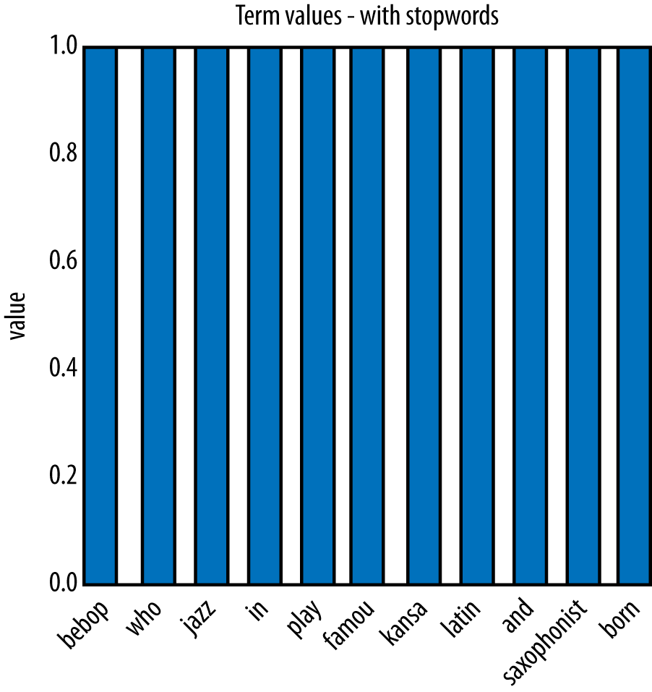
Scoring the search query

Slide 15
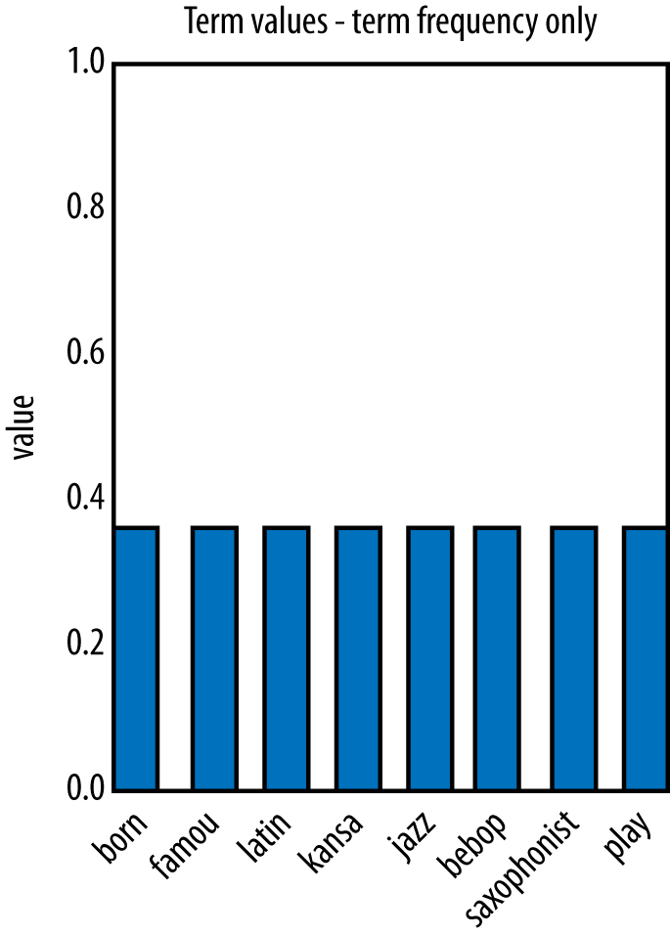
Scoring the search query

Slide 16
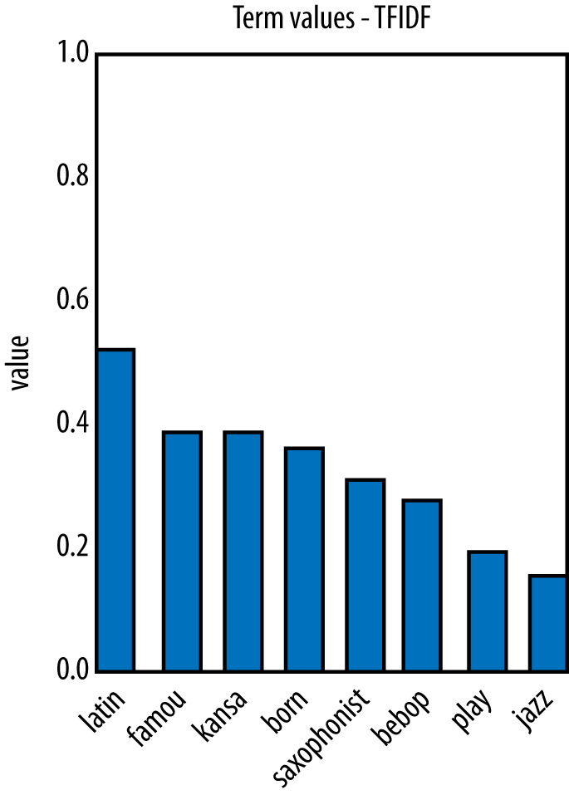
Scoring the search query

Slide 17
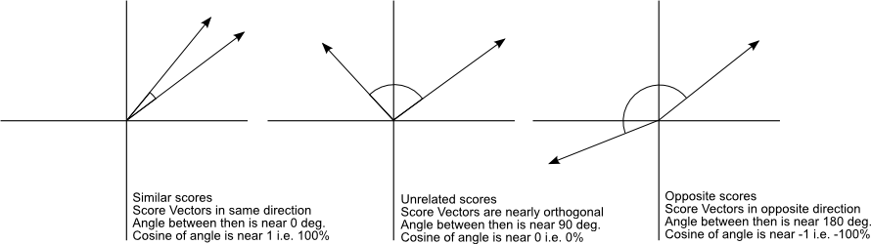
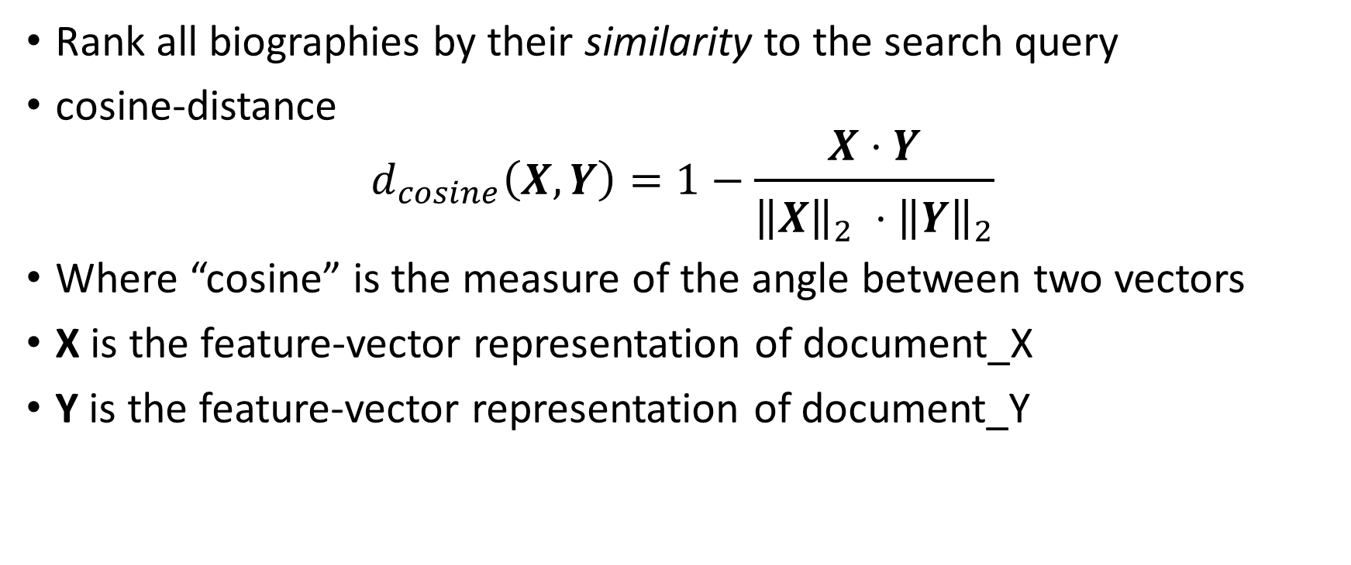
Rank all biographies by their similarity to the search query
cosine-distance
$$d_{cosine}\left(X,Y\right)=1−\frac{X⋅Y}{{\left\|X\right\|}_{2} ⋅{\left\|Y\right\|}_{2}}$$
Where “cosine” is the measure of the angle between two vectors
X is the feature-vector representation of document_X
Y is the feature-vector representation of document_Y

Slide 18
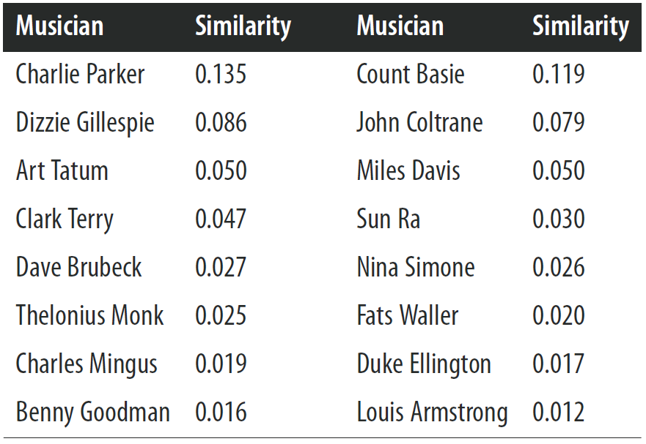
Example: Jazz Musicians. Cosine distance between search query and biographies of each musician.
Based on these similarity scores, which musician should we put at the top of our search results?

Slide 19
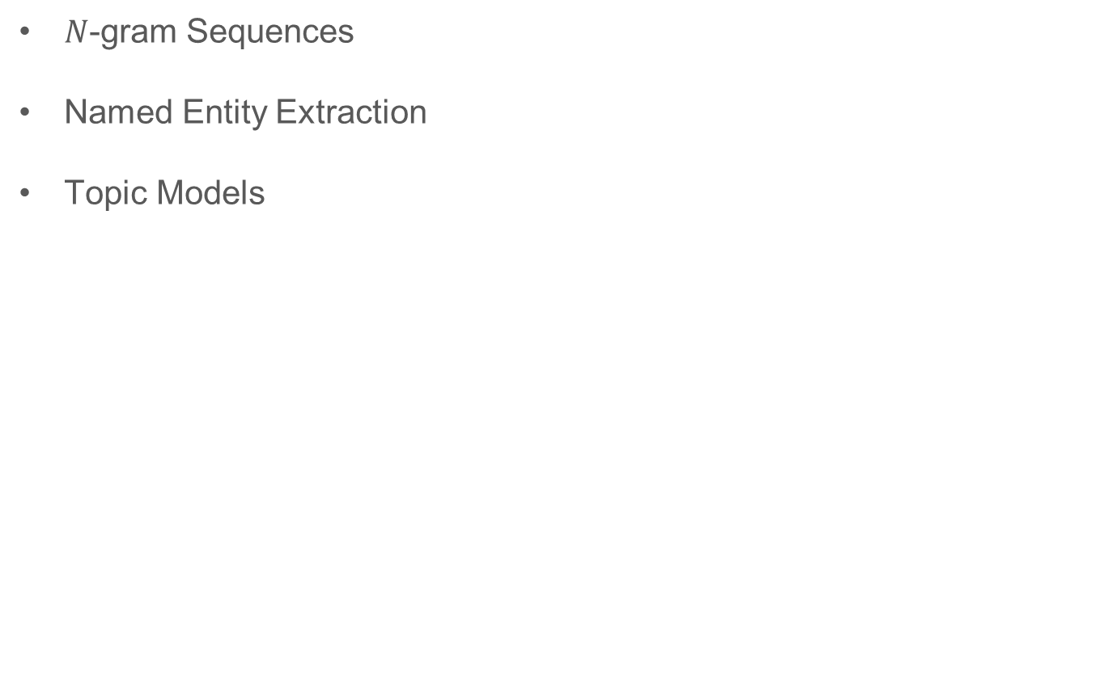
Beyond “Bag of Words”
$N$-gram Sequences
Named Entity Extraction
Topic Models

Slide 20
N-gram Sequences
In some cases, word order is important and you want to preserve some information about it in the representation
A next step up in complexity is to include sequences of adjacent words as terms
Adjacent pairs are commonly called bi-grams
Example: “The quick brown fox jumps” with all n-grams up to n=2.
It would be transformed into {quick, brown, fox, jumps, quick_brown, brown_fox, fox_jumps}
N-grams greatly increase the size of the feature set

Slide 21
Named Entity Extraction
Dictionary of known phrases, like titles, countries, names, that should not be separated into individual tokens.
e.g., “Silicon Valley, New York Mets, Department of the Interior, and Game of Thrones”
You have to provide the dictionary.

Slide 22
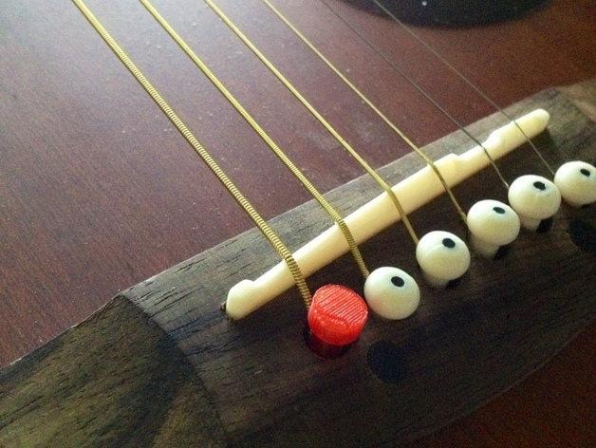
Topic Models
Say someone is searching for a specific thing, like a guitar part, but they don’t know what it’s called
How might you google search for this?

Slide 23
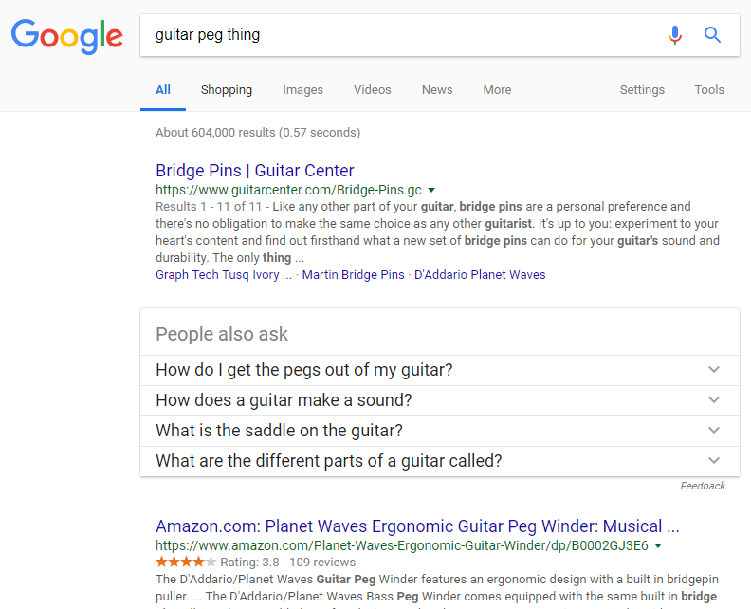
???

Slide 24
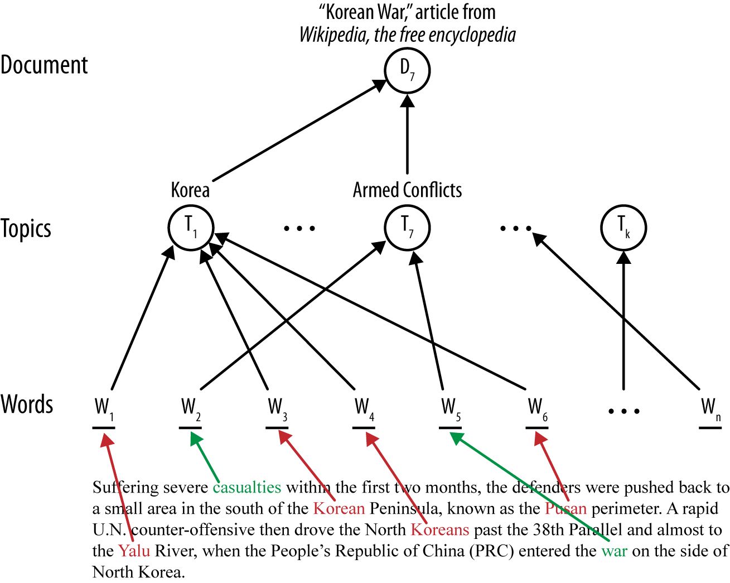
Topic Models
You cluster all tokens in a corpus based on tokens that they are “similar to”, or that they appear along with in a single document.
These clusters of words correspond to “topics”, with some words weighting more heavily towards one topic than another.
It is up to you to “label” the topics, as with centroid-based cluster labeling.
Benefit – if a search query contains a word that is not in a document, but that corresponds to a topic that is in that document, you can flag that document as being similar, despite not sharing the word.

Slide 25
Another example: Text Mining with Bag of Words
Task: predict the stock market based on the words in stories that appear on the news wires

Slide 26
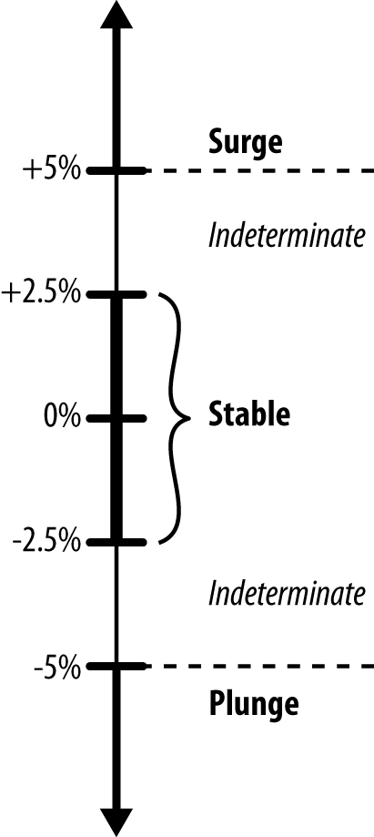
Mining News Stories to Predict Stock Price Movement
Our target variable will be a simple binary “stable or not stable?”, where “not stable” could be either “surge” or “plunge”

Slide 27
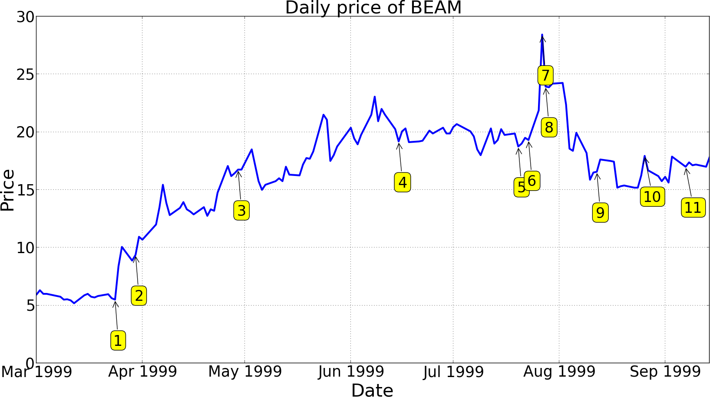
Mining News Stories to Predict Stock Price Movement

Slide 28
Sample news story. How would we preprocess it? What statistic could we use for each token?
What tokens from this article would you guess to be predictive of “change” or “no change”
1999-03-30 14: 45: 00
WALTHAM, Mass.--( BUSINESS WIRE)--March 30, 1999--Summit Technology, Inc. (NASDAQ:BEAM) and Autonomous Technologies Corporation (NASDAQ:ATCI) announced today that the Joint Proxy/ Prospectus for Summit's acquisition of Autonomous has been declared effective by the Securities and Exchange Commission. Copies of the document have been mailed to stockholders of both companies. "We are pleased that these proxy materials have been declared effective and look forward to the shareholder meetings scheduled for April 29," said Robert Palmisano, Summit's Chief Executive Officer.
lowercase all, stem words, remove punctuation and stopwords, feature such as TF-IDF
Use the date of the news study to flag each document as being either 1 (stock price change) or 0 (no stock price change)

Slide 29
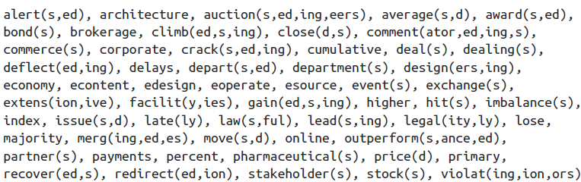
Mining News Stories to Predict Stock Price Movement
These terms were found to be “important”

Slide 30
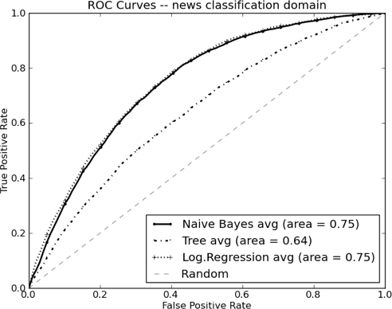
Mining News Stories to Predict Stock Price Movement

Slide 31
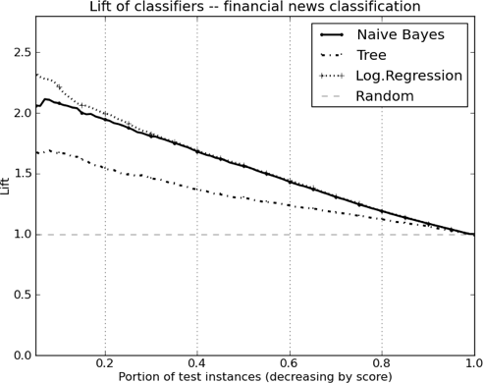
Mining News Stories to Predict Stock Price Movement

Slide 32
Many figures in this slide deck from Provost, F., & Fawcett, T. (2013). Data science for business: what you need to know about data mining and data-analytic thinking. Sebastopol, Calif.: O'Reilly.

